Slide 1

Land Cover Land Use Change Science Team meeting
May 8-9, 2023
Goddard
Goddard
Assessing the impact of urban land conversion on local and regional surface climate and its socio-economic consequence
Team Members
Alexey N. Shiklomanov (PI), NASA Goddard Space Flight Center
Zarrar Khan (Co-I), Pacific Northwest National Laboratory
Tao Zhang (Co-I), Iowa State University
Collaborators
Lahouari Bounoua (New PI), NASA Goddard Space Flight Center
Yuyu Zhou, Iowa State University
Hicham Bahi (Mohamed VI Polytechnic University)
Mohamed Yacoubi (University of Marrakech)
Mengqi Zhao (Pacific Northwest National Laboratory)
Joseph Nigro (Science Systems and Applications, Inc.)
Lahouari Bounoua

Slide 2

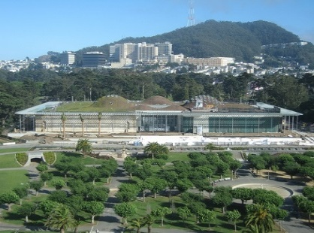

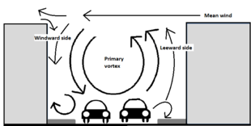

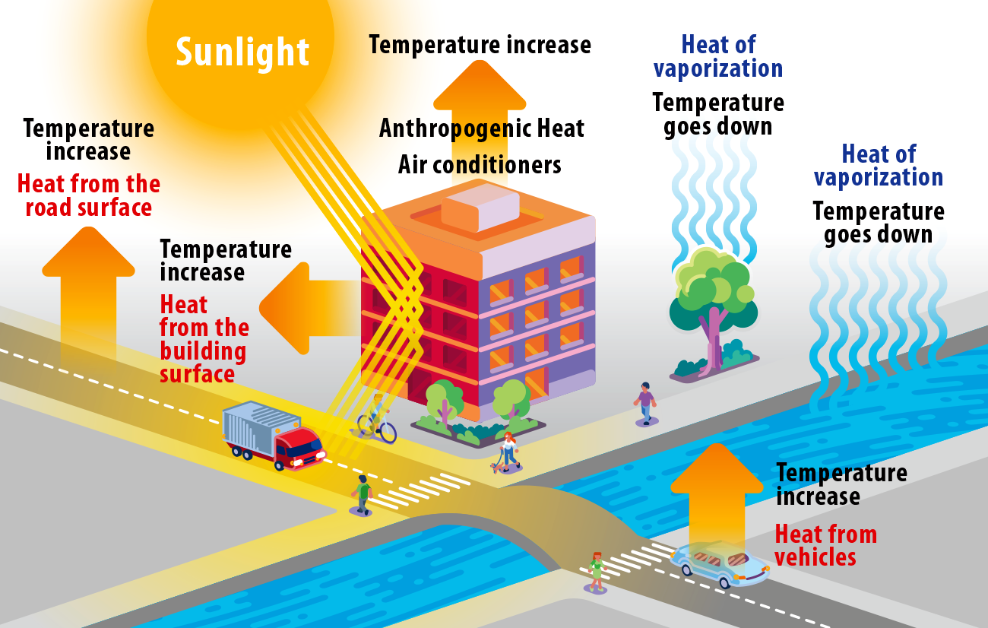
Land Cover Land Use Change Science Team meeting
May 8-9, 2023
Goddard
Goddard
Challenges in Urban Science
Cities are not built the same way …nor are they built with same materials
Difficult to characterize them across the globe and study their impacts at global scales
Urbanization must be mapped at a scale that resolves
the urban metabolism
Cities, interact with atmosphere and require multi-level models
that capture both the lateral and vertical mass and energy fluxes
People, in cities, create coupled anthropogenic-natural interactions that require detailed socio-economic modeling.
Lahouari Bounoua

Slide 3
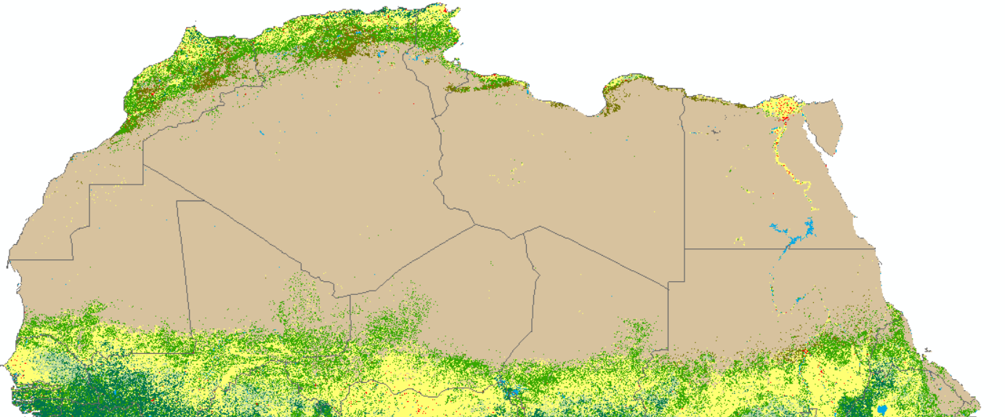
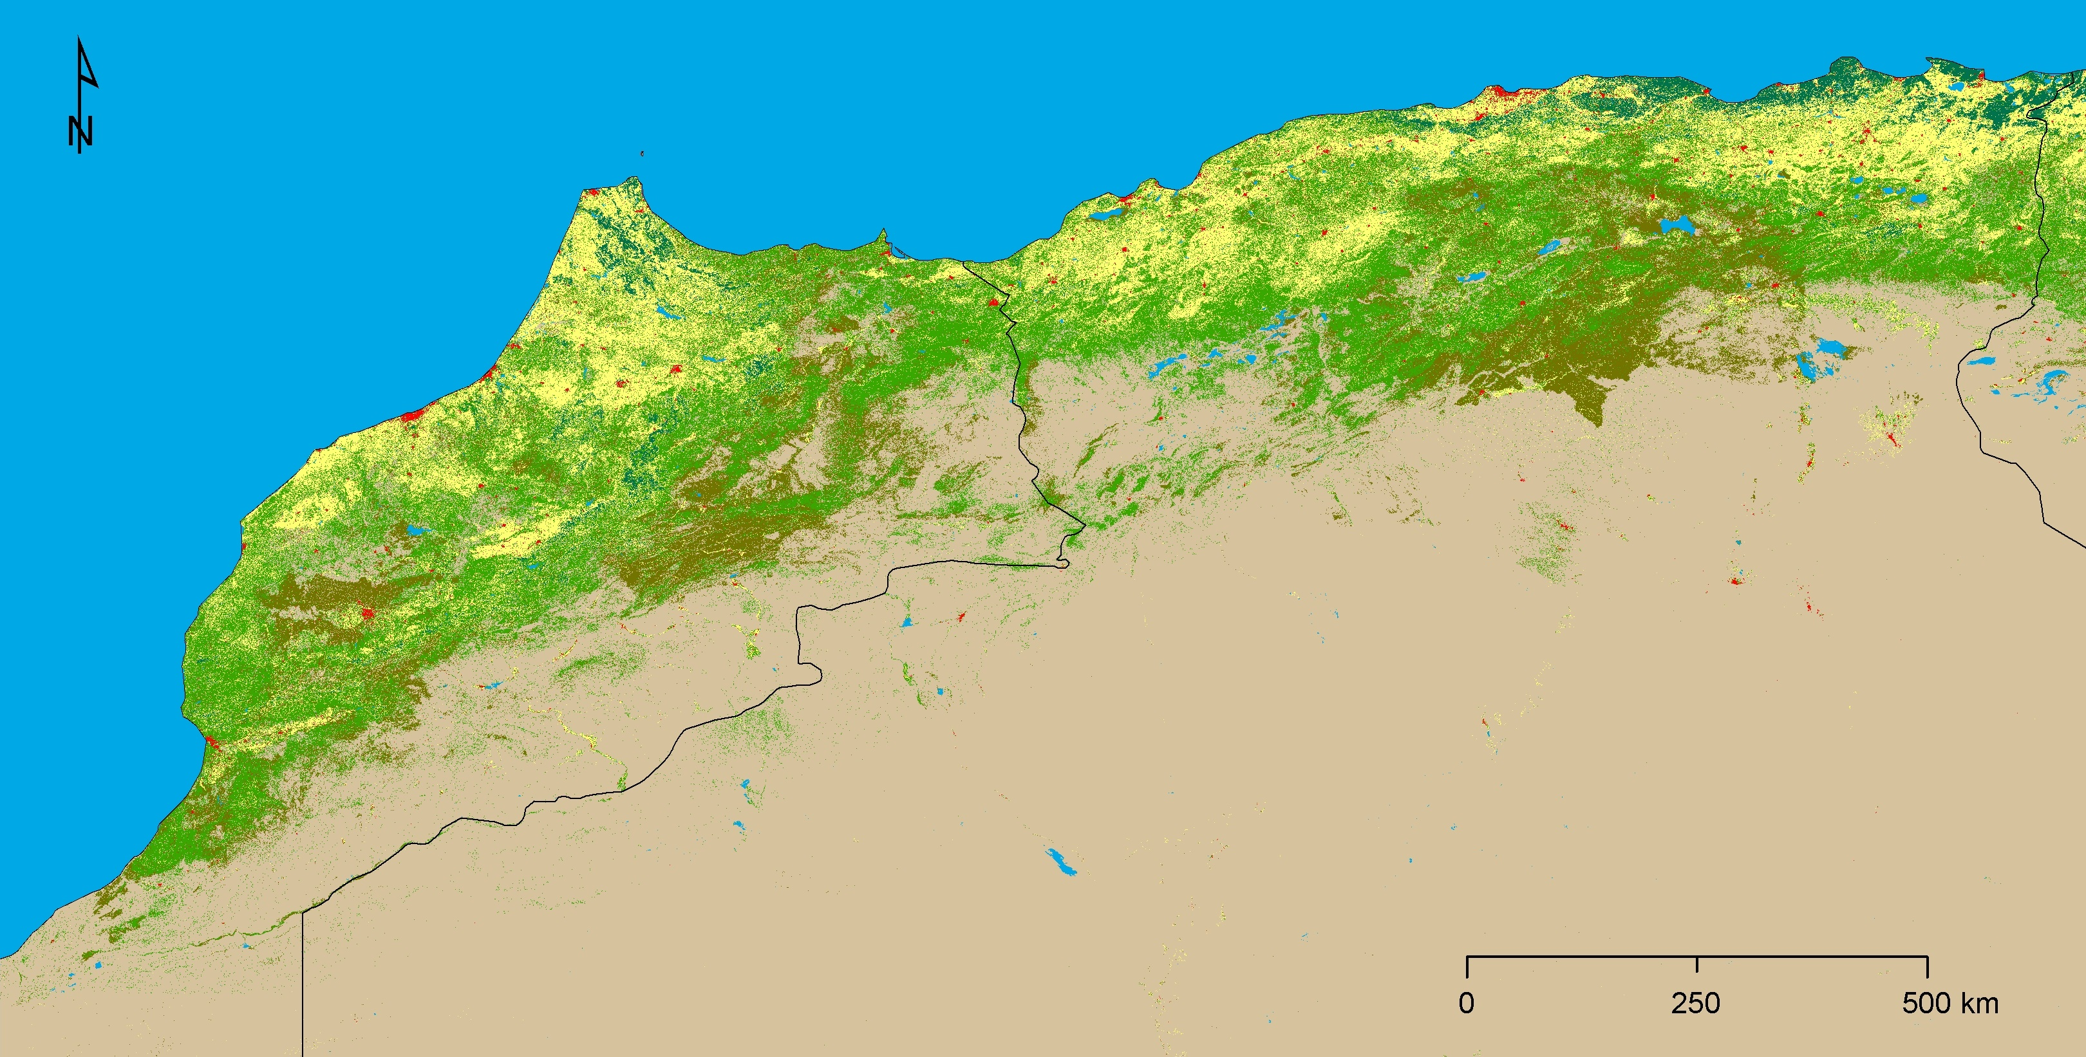
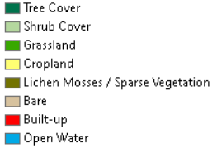
Land Cover Land Use Change Science Team meeting
May 8-9, 2023
Goddard
Goddard
Northwest Africa as a hot spot
Northwest Africa is mostly desert and about 80% of the population live in about 20% of the land
With increase in population, land conversion to urban is happening on fertile arable lands
The risk of desertification due to climate is challenged by that due to urbanization ….
ESA 2016 Climate Change Initiative (CCI)
Land Cover (20m)
Algiers
Tangier
Oran
45 miles
Rabat
Casablanca
Saouira
Morocco
Marrakesh
Agadir
Algeria

Slide 4
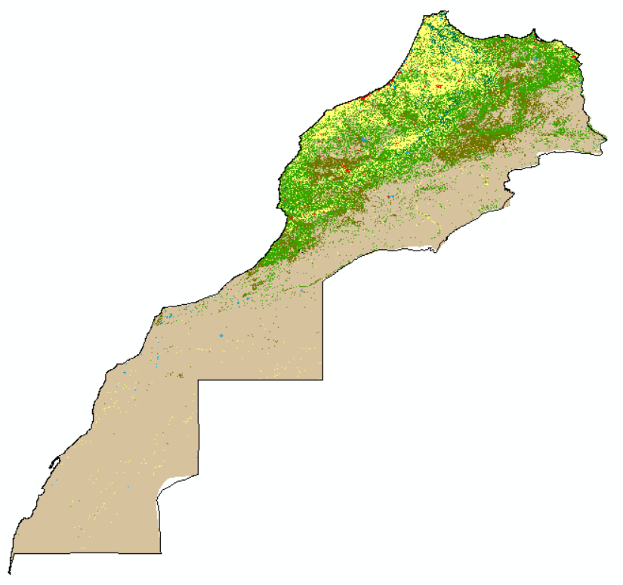
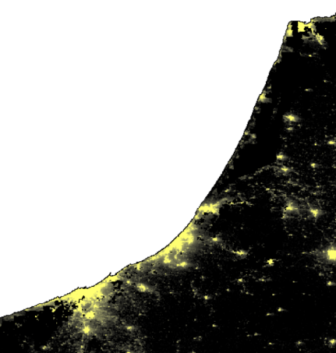

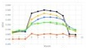
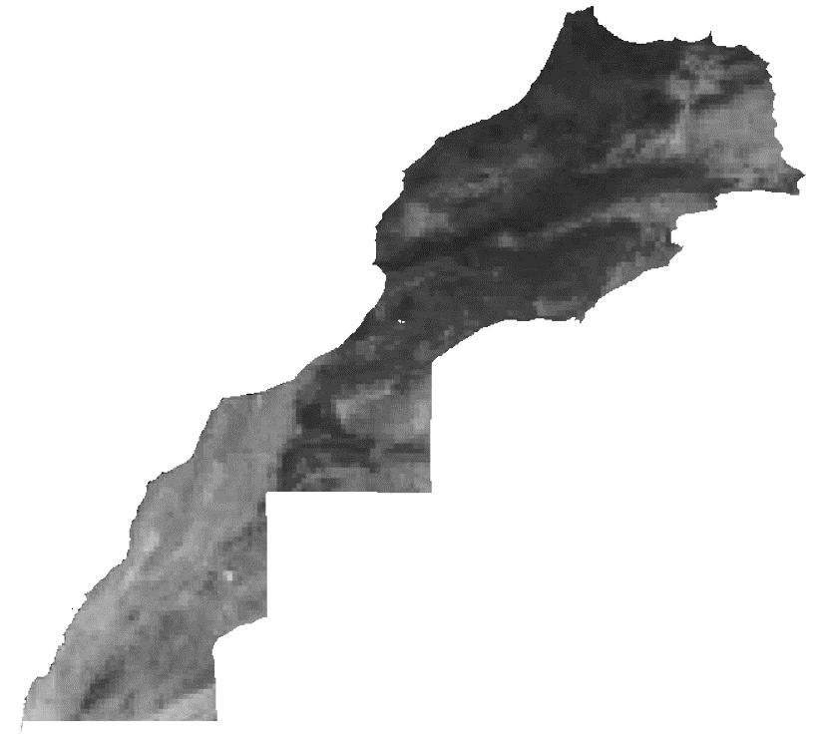
Land Cover Land Use Change Science Team meeting
May 8-9, 2023
Goddard
Objectives of the study
Map urbanization in cities of Morocco, analyze the thermal structure UHI/UHS
Simulate the impact of buildup on surface climate
Understand the impact of urbanization on the vertical structure of the lower troposphere.
Quantify the economic consequences of urban heating/cooling in terms of energy demand
Tasks 1 &2
Task 3
2004 & 2014 Offline Continental Simulations
2004 & 2014 Coupled Regional Simulations
Tangier
Static
Geography
Data
WRF
Landsat
‘Urban chain’
Noah
land-surface
model
GMAO MERRA-2
Rabat
Real-time
Weather
Data
Urban canopy
model
MODIS
Casablanca
Land Cover Map
Initial Conditions
LIS
Modeling
Testbed
Biophysical Attributes
GCAM
FPAR/LAI
UHI Precipitation Runoff
Task 4
Albedo/Zo
Building
Energy Demand
Surface Albedo Map
Lahouari Bounoua

Slide 5
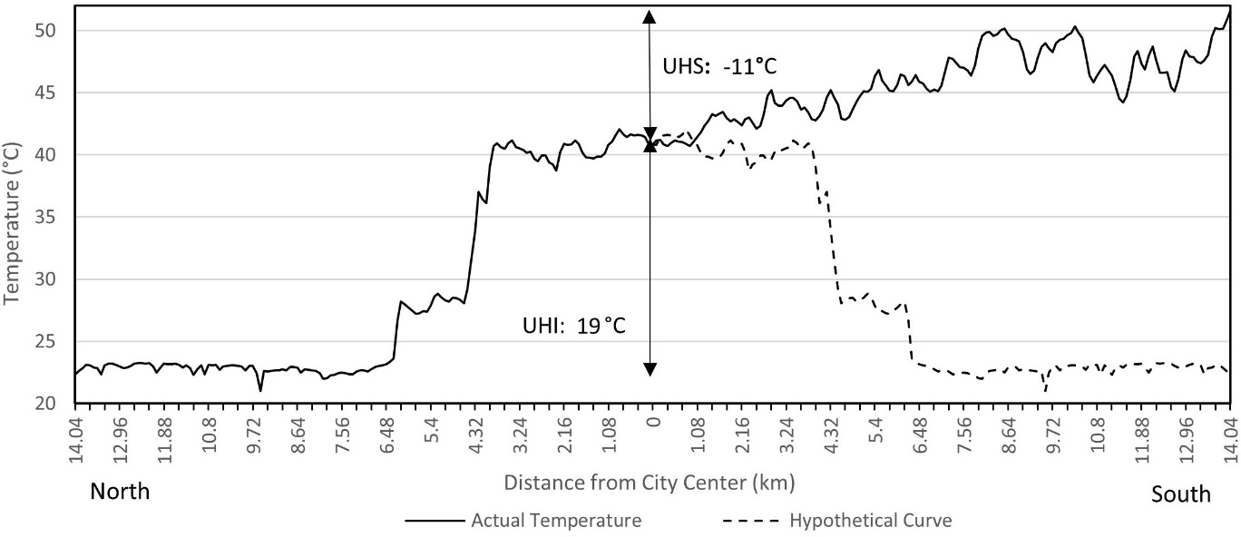
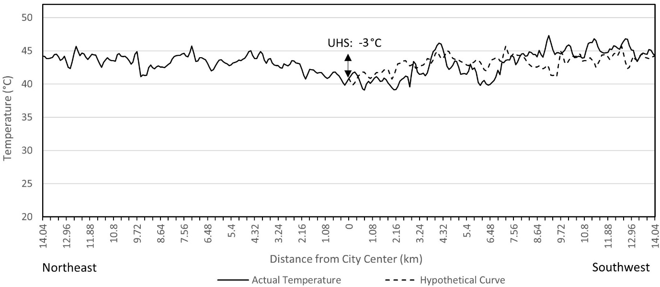
Land Cover Land Use Change Science Team meeting
May 8-9, 2023
Goddard
Goddard
Preliminary Results – Task 1
Land cover for the urban area of Casablanca
Surface temperature cross section along a north-south transect perpendicular to the coastline and across the city of Casablanca.
Surface temperature cross section along a northeast-southwest transect parallel to the coastline and across the city of Casablanca
Lahouari Bounoua

Slide 6

Goddard
Preliminary Results – Task 1
(A) Land cover classification in the region of Oujda, (B) Urban extension.
Surface temperature cross section along a North-South transect across Oujda
Surface temperature cross section along a East-West transect across Oujda
Lahouari Bounoua

Slide 7
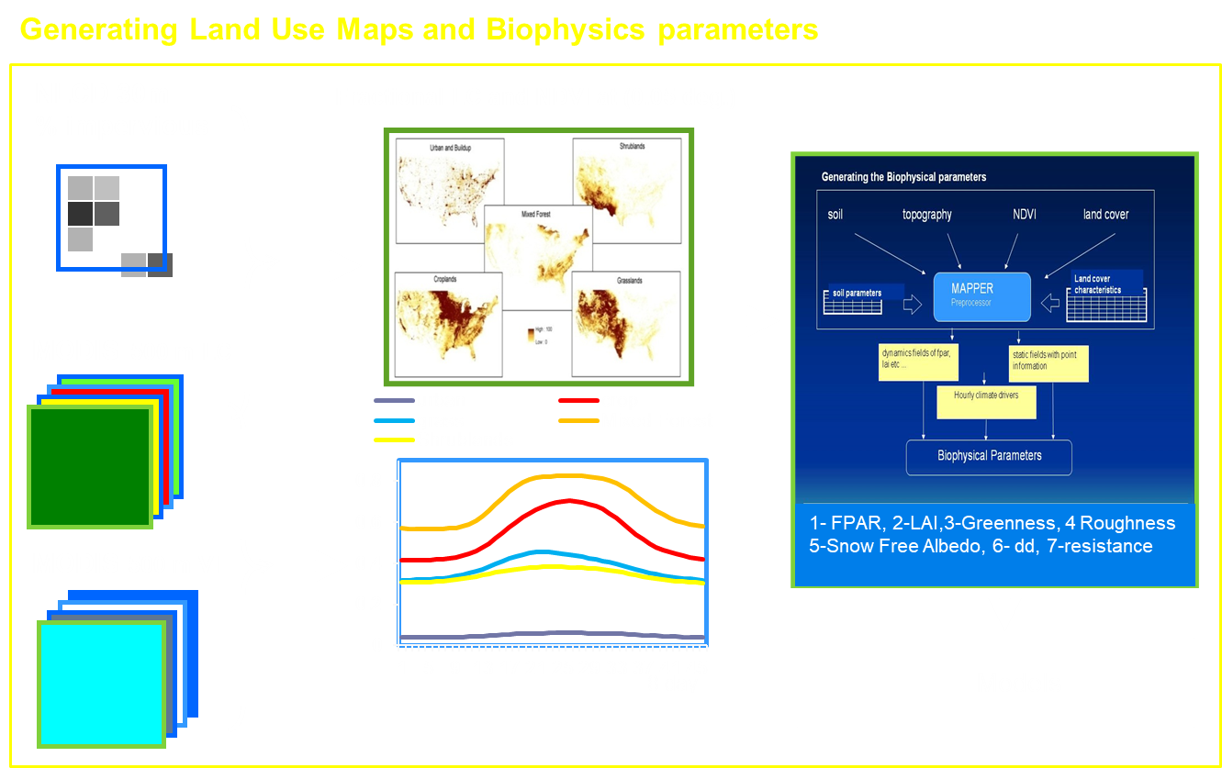
Land Cover Land Use Change Science Team meeting
May 8-9, 2023
Goddard
Goddard
Preliminary results task2
Landsat 30 m
Lahouari Bounoua
Notes:
We merged Landsat-based impervious surface and MODIS products within a Climate Modeling Grid (CMG) of 0.05° x 0.05° latitude-longitude to describe the urban and vegetation phenology over the continental United States. We then use these data in the Simple Biosphere model to simulate the individual and combined response of each land cover class co-exiting in the grid.
This methodology allows us to :
1- Capture the urban metabolism
2- describe urban ecosysteme within its non-urban (vegetated) surrounding
3- develop a practical computing grid with available climatological drivers

Slide 8
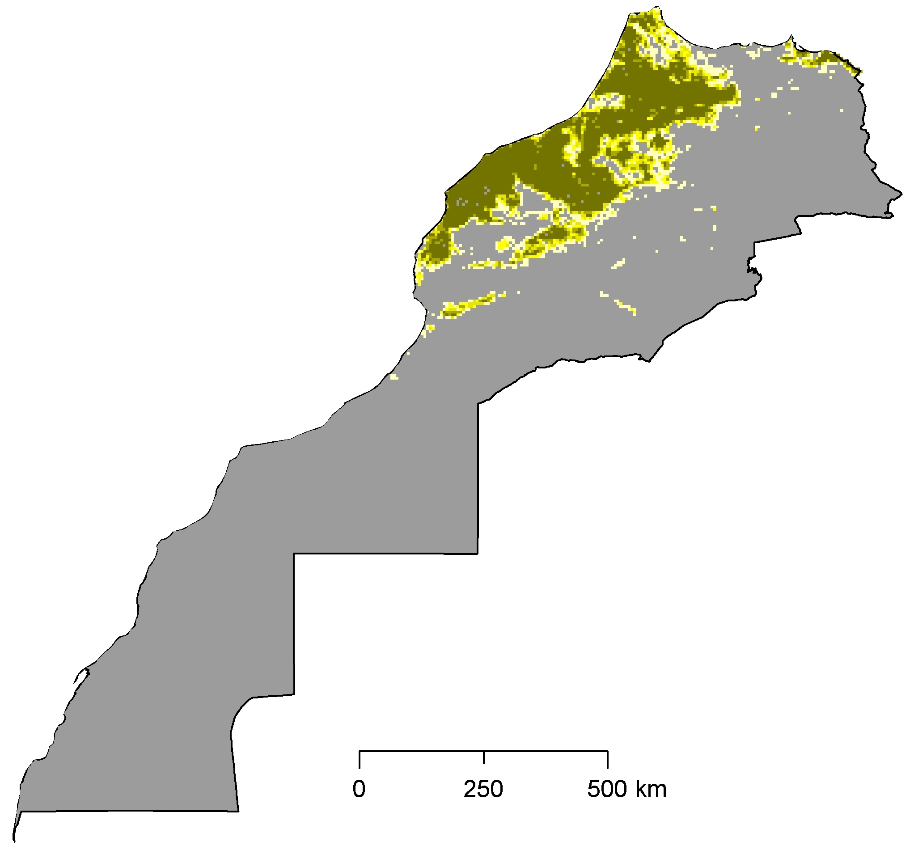
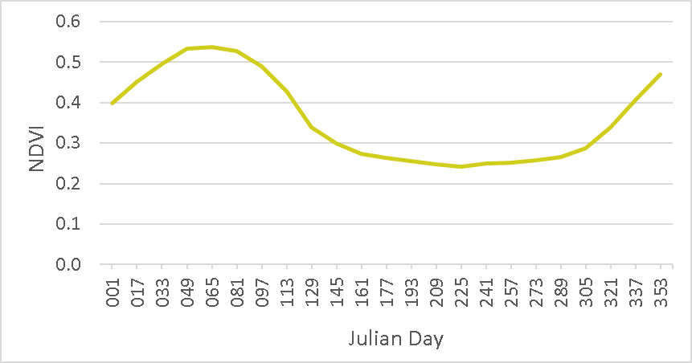
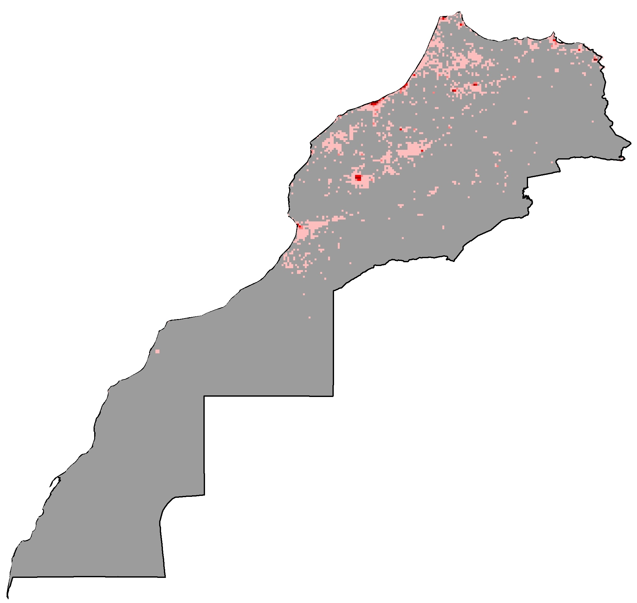
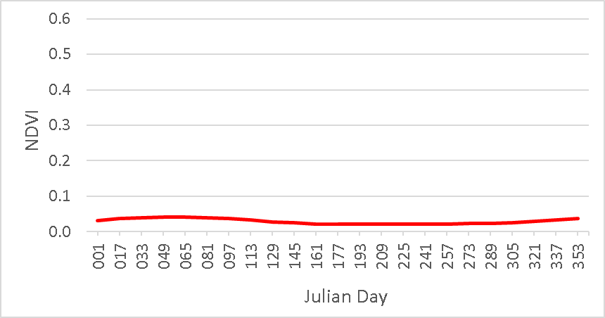
Land Cover Land Use Change Science Team meeting
May 8-9, 2023
Goddard
Croplands 2014 Average NDVI
Preliminary results task2
Urban 2014 Average NDVI (Scaled)
NOTE: This slide is the same as the 1st one except I plotted the scaled-down (divided by 10) NDVI in the way we process it for the SiB2 model input.
Lahouari Bounoua

Slide 9
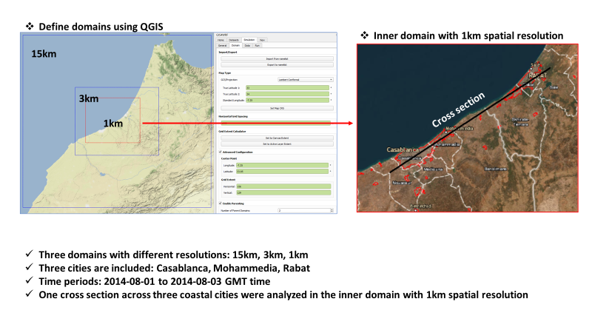
Land Cover Land Use Change Science Team meeting
May 8-9, 2023
Goddard
Goddard
Preliminary results task3
Lahouari Bounoua

Slide 10
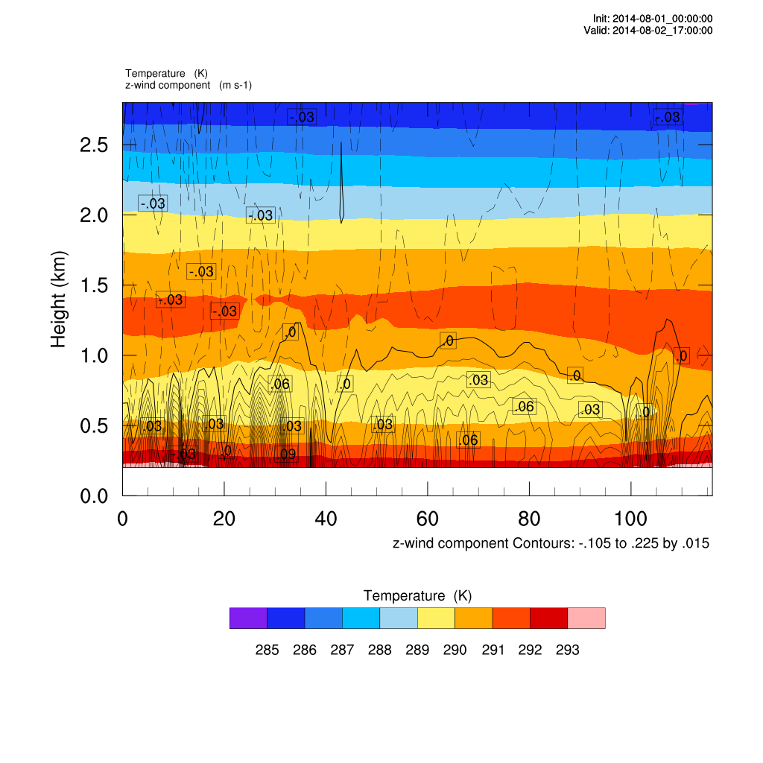
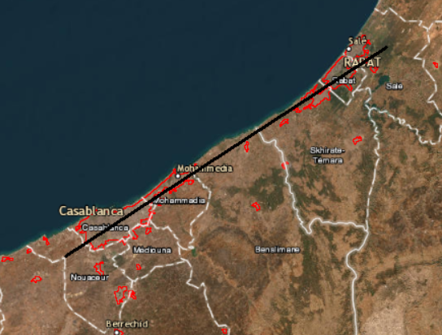
Land Cover Land Use Change Science Team meeting
May 8-9, 2023
Goddard
Preliminary results task2
Cross section
Rabat
Casablanca
Lahouari Bounoua
Notes:
Left figure: Vertical profile along the cross section at 17:00 of 2014-08-02 (GMT)
Color: air temperature (K); Contour: z-wind component (m/s)
X-axis: from southwest to northeast along the cross section; Y-axis: height from 0-3000 m
Right figure: remote sensing image of inner domain with 1km spatial resolution
Red polygons: urban boundary; black line: the cross section

Slide 11
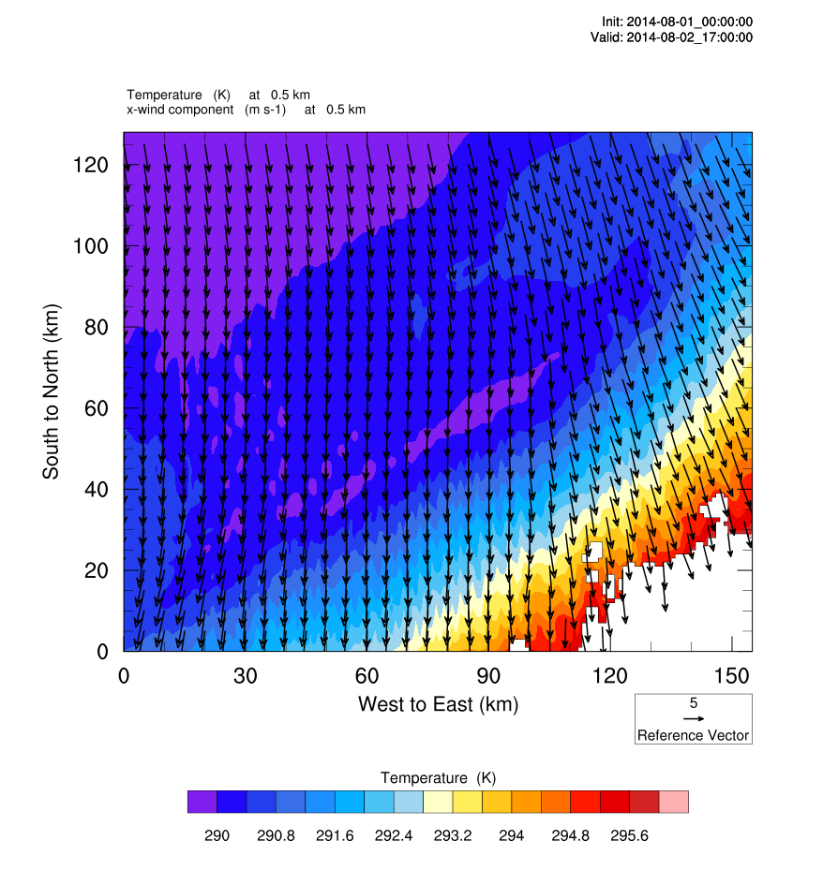
Land Cover Land Use Change Science Team meeting
May 8-9, 2023
Goddard
Goddard
Preliminary results task 3
Height: 0.5km
Wind from sea to land at 500m height at 17:00 of 2014-08-02 (GMT)
Sea breeze at 500m height at 17:00 GMT on August 8, 2014
Wind vector
y-wind component
x-wind component
Lahouari Bounoua
Notes:
Left figure: Horizontal temperature at the height of 0.5km at 17:00 of 2014-08-02 (GMT)
Color: air temperature (K); arrows: wind vector
X-axis: from west to east
Y-axis: from south to north

Slide 12
Land Cover Land Use Change Science Team meeting
May 8-9, 2023
Goddard
Goddard
Preliminary Results Task4
inputs provided by Task 1,2 & 3
2004
Temperature | confort Temperature | Population
Floorspace | building heights | Thermal conductance|
Per capita income / Demand Satiation | price of services
2014
Temperature | confort Temperature | Population
Floorspace | building heights | Thermal conductance|
Per capita income / Demand Satiation | price of services
Building Enrgy Demand (BED) Model
Estimate spatial distribution of energy demand
2004
Building energy demand for heating, cooling and other energy services
2014
Building energy demand for heating; cooling and other energy services
Without urban heat island effect
With urban heat island effect
Serves as reference scenario
Serves as UHI impact scenario
Validate with local data
Compare with local data
Emissions and electricity generation by fuel using GCAM
Emissions and electricity generation by fuel using GCAM
The objective of task 4 is to explore the impact of urban heat island (UHI)-induced changes in near-surface temperature and floor space on building energy heating and cooling demand, and how this shift will affect the corresponding electricity generation and emissions.
Lahouari Bounoua

Slide 13
Land Cover Land Use Change Science Team meeting
May 8-9, 2023
Goddard
Goddard
The proposal is in good shape
Dynamic team working together
Meeting monthly
Expect all deliverables to be on time
Lahouari Bounoua

Slide 14
Land Cover Land Use Change Science Team meeting
May 8-9, 2023
Goddard
Goddard
End

